Slide 1




DeepScan Pro
A DeepFake Detector
Presented By
Miss. Shreya R. Jadhav
Mr. Dhananjay R. Ambatwar
Mr. Manasvi H. Mude
Mr. Aryan S. Tapase
Under the Guidance of:
Prof. Mr. Swapnil T. Powar

Slide 2
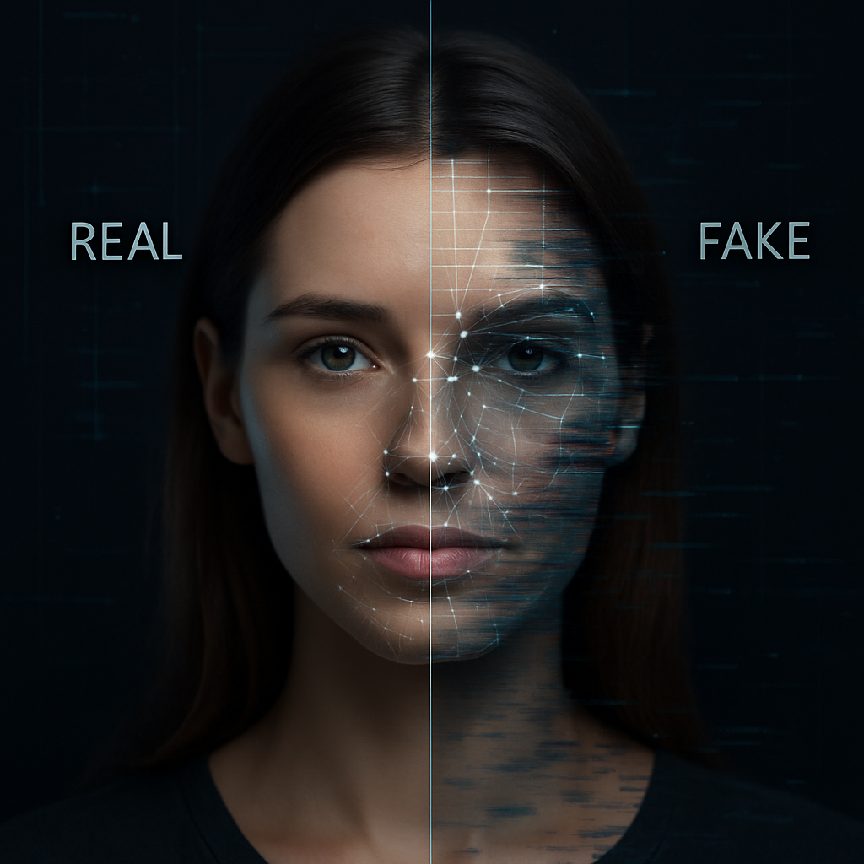
Introduction
DeepScan Pro is an advanced system designed to detect deepfake media across images, videos, and audio.
It uses machine learning and deep learning to identify manipulations by analyzing facial movements, lighting, and audio patterns.
With real-time detection and high accuracy, it helps maintain media authenticity in areas like journalism, law enforcement, and digital forensics.
Proposed System:
The system employs a multi-modal strategy, integrating the analysis of images, videos, and audio to ensure comprehensive, efficient, and reliable detection of deepfakes.

Slide 3
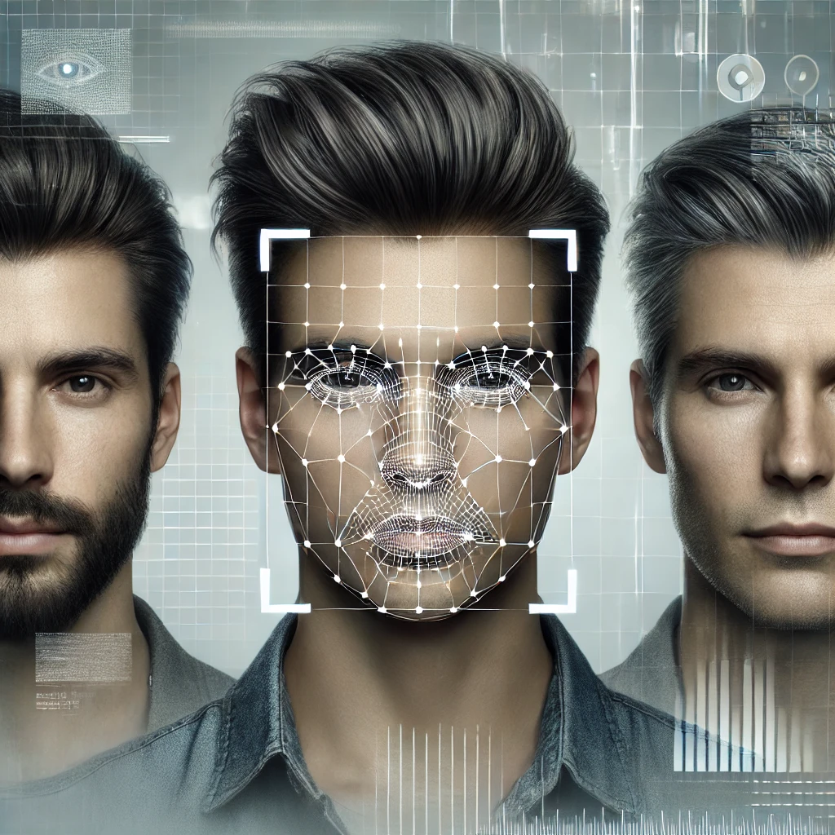
LITERATURE SURVEY
Yan Wang et al. – Improves video deepfake detection using frequency filtering, denoising, and attention fusion.
Jayashre K et al. – Combines Inception ResNet + BiLSTM with spotted hyena optimization for better video accuracy.
Rahul TP et al. – Uses ResNet-34 with Mel-spectrograms to detect ASV spoofing; suggests GANs for future improvement.
Rul Liu et al. – Converts mono to binaural audio for better deepfake detection using multi-space representations.

Slide 4
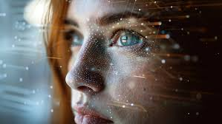
Our Motivation
01
Deepfake Threat Awareness
02
AI Media Misuse Concern
03
Reliable Detection Goal
04
ML for Media Integrity

Slide 5
PROBLEM STATEMENT
“To develop a system that detect deepfakes in media such as images, videos, and audio.”
Objectives
To develop a multi-modal deepfake detection system integrating images, videos, and audio.
To design and implement an improved user interface for enhanced user experience.
To test and validate the system on a comprehensive dataset of diverse deepfake media, ensuring its applicability in real-world scenarios.

Slide 6
REQUIREMENT ANALYSIS
DATASET
Image Dataset: 13,000 facial images, equally split between real and AI-generated. Includes 3,000 custom Indian images and public datasets with varied lighting, age groups, and ethnicities to improve detection accuracy.
Audio Dataset: Combines real and synthetic clips in Indian languages using custom recordings, ASVspoof for spoofing techniques, and SceneFake for real-world noisy audio detection.
Video Dataset: Uses Celeb-DF V2 for high-quality deepfakes and a custom Hindi audio-video dataset to test facial and vocal manipulations in regional contexts.

Slide 7
REQUIREMENT ANALYSIS
HARDWARE REQUIREMENTS
OS: Windows 10/11, macOS, or Linux.
Processor: Min: Intel i5 / Ryzen 5 | Rec: Intel i7/i9 or Ryzen 7/9.
RAM: Min: 8 GB | Rec: 16 GB or more.
Storage: Min: 512 GB | Rec: 1 TB SSD.
GPU: Optional, but GTX 1660 / RTX 2060+ recommended for faster training.
SOFTWARE REQUIREMENTS
Language: Python 3.8+ for ML and data science support.
Environments: Google Colab (GPU), Jupyter Notebook, VS Code.
OS Compatibility: Windows, Linux, macOS.
Version Control: Git and GitHub for collaboration and tracking.

Slide 8
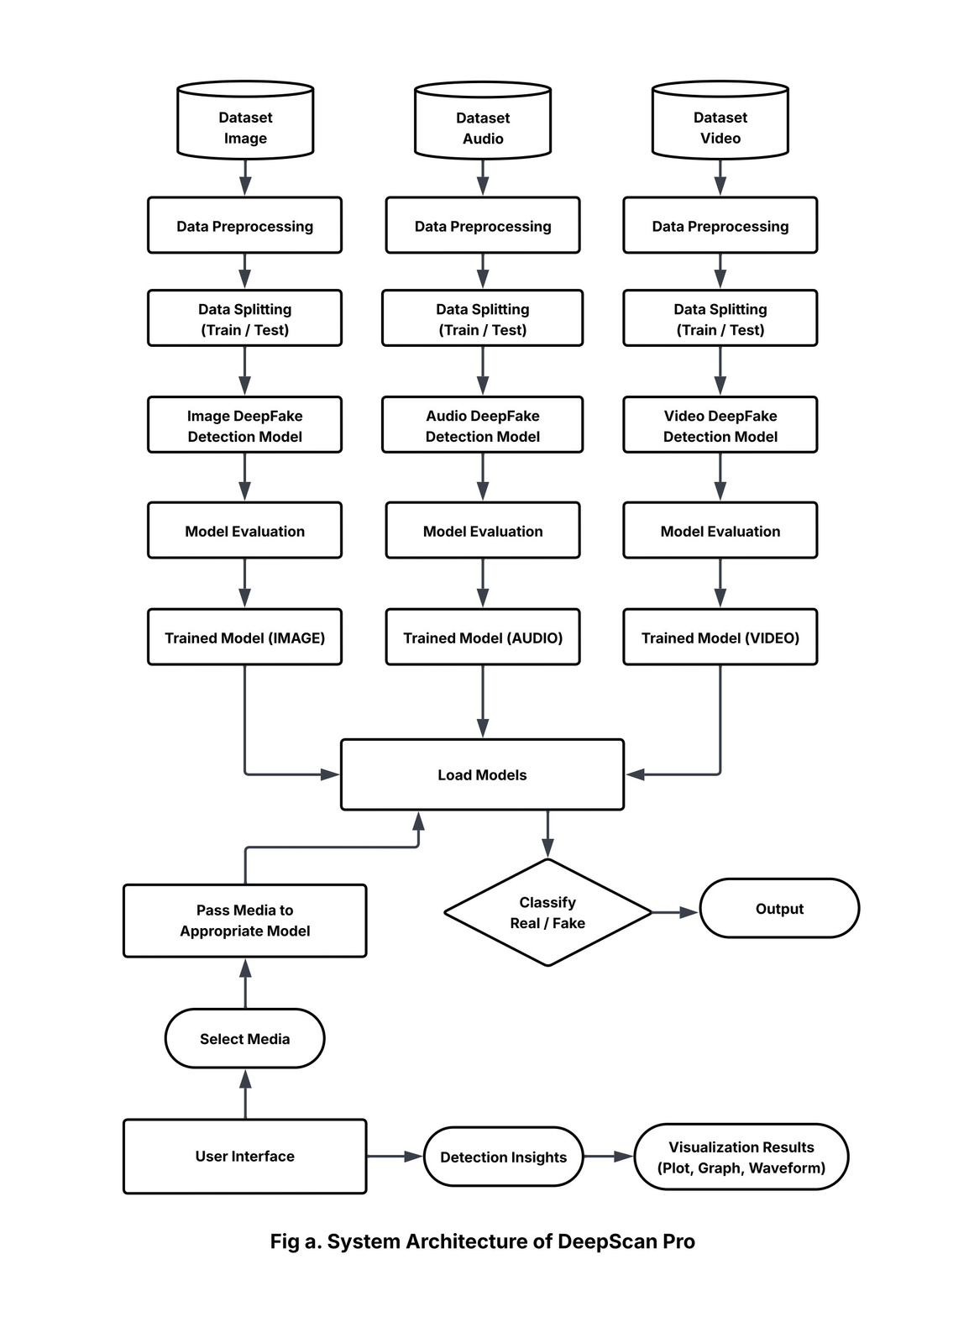
SYSTEM DESIGN
System Architecture
Data Collection: Custom + public datasets (CelebDF v2, ASVspoof, SceneFake, Hindi sets) for image, audio, and video deepfakes.
Data Preprocessing: Faces cropped, audio embedded (Wav2Vec2), video frames analyzed.
Model Training:
Image: Swin Transformer + neural classifier.
Audio: Wav2Vec2 + BiLSTM.
Video: ResNeXt50 + LSTM
Model Evaluation: Accuracy
Interface Development: Built in Flet, supports media input with real-time fake detection.

Slide 9
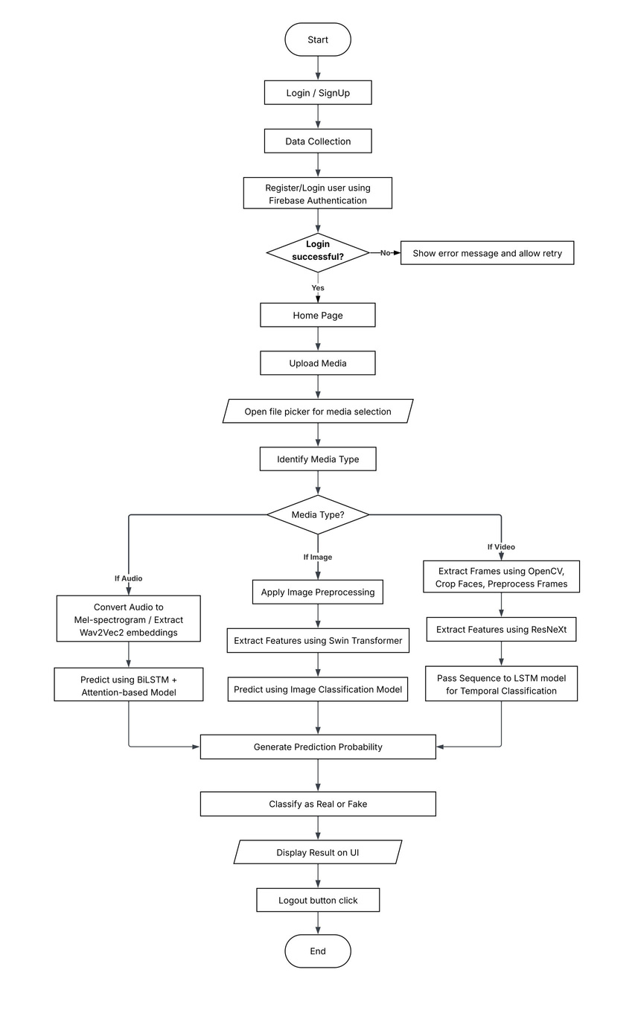
IMPLEMENTATION
Algorithm
Input: User credentials, media file
Output: Real or Fake classification
Steps:
User signs up/logs in via Firebase.
After login, user uploads media (image / audio / video).
System detects media type and applies relevant preprocessing.
Image: Swin Transformer + neural classifier
Audio: Wav2Vec2 + BiLSTM
Video: ResNeXt + LSTM
Model predicts authenticity.
Result is displayed on UI; user can log out.

Slide 10
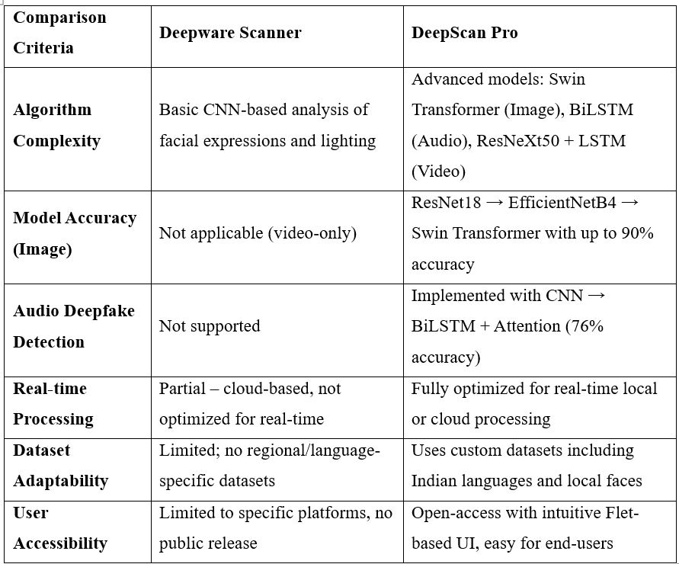
RESULT ANALYSIS
Comparison between Deepware Scanner and DeepScan pro
Image Classification:
Swin Transformer: Best performer with 90% accuracy.
Outperformed EfficientNetB4 (75%) and ResNet18 (67%).
Audio Classification:
Wav2Vec2 achieved 76% accuracy, better than Audio CNN (64%).
Video Classification:
ResNeXt + LSTM reached 87% accuracy, effective in capturing spatial + temporal features.
-------------------------------------------------------------------------------

Slide 11
CONCLUSION
DeepScan Pro is a powerful multi-modal deepfake detector for images, audios, and videos. It uses advanced models like Swin Transformer, Wav2Vec2 + BiLSTM, and ResNeXt + LSTM to identify manipulations. With a user-friendly interface and real-time analysis, it is effective for real-world use in fields like journalism and law enforcement. It outperforms existing tools by offering broader media support, regional datasets, and explainable outputs.
Enhanced transformer models.
Comprehensive detection of full-image deepfakes, multilingual audio capabilities, and social media integration.
Availability on mobile or browser platforms.
FUTURE SCOPE

Slide 12
REFERENCES
[1] Wang et al. : Detects compressed deepfakes using frequency filtering, denoising, and attention fusion.
[2] Jayashre & Amsaprabhaa : Uses Inception ResNet + BiLSTM with spotted hyena optimization for video deepfakes.
[3] Rahul et al. : Detects audio spoofing with ResNet-34 and Mel-spectrograms using transfer learning.
[4] Liu et al. : Converts mono to binaural audio for better fake audio detection via multi-space representations.
[5] Sharma et al. : GAN-CNN model with generative replay for social media deepfakes.
[6] Wang et al. : Combines spatial and frequency features using knowledge distillation for better detection on compressed data.
[7] Li et al. : Uses transformer-based cross-modal fusion for robust multi-modal deepfake detection.

Slide 13
publication details
We are pleased to announce the publication of our research paper titled “DeepScan Pro - A Deepfake Detector” in the International Journal of Creative Research Thoughts (IJCRT).
Volume: 13
Issue: 5
Date: May 2025
ISSN: 2320-2882
Paper ID: 285218
Page Numbers: b673-b680
You can access the published paper at the following links:
Published Paper PDF: http://www.ijcrt.org/papers/IJCRT2505188
Published Paper URL: http://ijcrt.org/viewfull.php?&p_id=IJCRT2505188
Published Paper PDF Download: https://ijcrt.org/download.php?file=IJCRT2505188.pdf

Slide 14
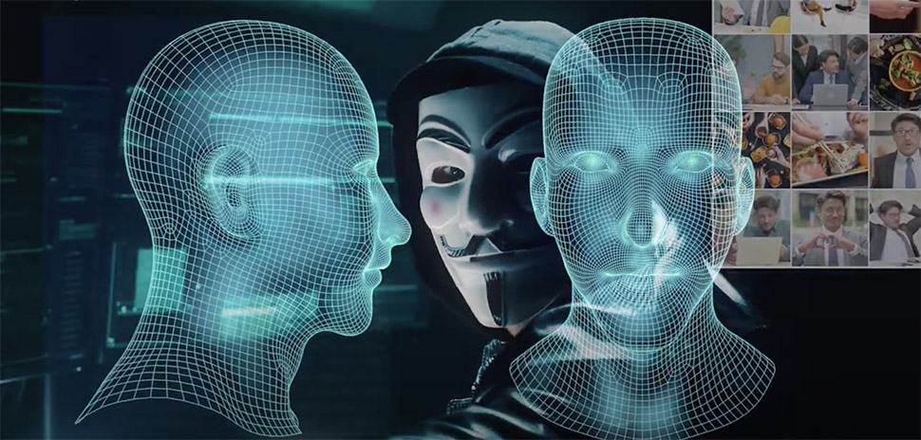
Thank You

